Slide 1
Excel Lesson 3 Organizing the Worksheet
Microsoft Office 2010 Introductory
Pasewark & Pasewark

Slide 2
Objectives
Copy and move data in a worksheet.
Use the drag-and-drop method and Auto Fill options to add data to cells.
Insert and delete rows, columns, and cells.
Freeze panes in a worksheet.
Split a worksheet window.
2
2

Slide 3
Objectives (continued)
Check spelling in a worksheet.
Prepare a worksheet for printing.
Insert headers and footers in a worksheet.
3
3

Slide 4
Vocabulary
automatic page break
copy
cut
fill handle
filling
footer
freeze panes
header
manual page break
margin
Normal view
Office Clipboard (Clipboard)
Page Break Preview
4
4

Slide 5
Vocabulary (continued)
Page Layout view
paste
print area
print titles
scale
split
5
5

Slide 6
Copying and Moving Cells
Copying duplicates the cell or range in another location, while also leaving the cell in its original location.
Cutting removes a cell or range from its original location in the worksheet.
Pasting places the cell or range in another location.
6
6

Slide 7
Copying and Moving Cells (continued)
To copy a cell or range, use buttons in the Clipboard group on the Home tab.
The copied data is placed on the Office Clipboard. The Office Clipboard (or Clipboard) is a temporary storage area for up to 24 selections you copy or cut.
To move a cell or range, you use the Cut button, followed by the Paste button.
7
7

Slide 8
Copying and Moving Cells (continued)
Range copied to the Clipboard

Slide 9
Copying and Moving Cells (continued)
You can quickly move or copy data using the drag-and-drop method. First, select the cell or range, then drag them to a new location.
To copy cells, press and hold the Ctrl key.
Filling copies a cell’s contents and/or formatting into an adjacent cell or range.
You can use the fill handle to help with copying cells and also to continue a series of text items, numbers, or dates.
9
9

Slide 10
Inserting and Deleting Rows, Columns, and Cells
To insert a row, click the row heading to select the row where you want the new row to appear. Then, click the Insert button on the Home tab.
To insert a column, click the column heading to select the column where you want the new column to appear. Then, click the Insert button.
10
10

Slide 11
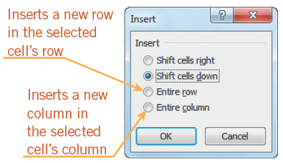
Inserting and Deleting Rows, Columns, and Cells (continued)
To delete a row or column, click the appropriate row or column heading and then click the Delete button on the Home tab.
Use the buttons in the Cells group on the Home tab to insert and delete cells.
Insert dialog box
11
11

Slide 12
Freezing Panes in a Worksheet
You can view two parts of a worksheet at once by freezing panes.
When you freeze panes, you select which rows and/or columns of the worksheet remain visible on the screen as the rest of the worksheet scrolls.
12
12

Slide 13
Splitting a Worksheet Window
Splitting divides the worksheet window into two or four panes that you can scroll independently.
This enables you to see different parts of a worksheet at the same time.
13
13

Slide 14
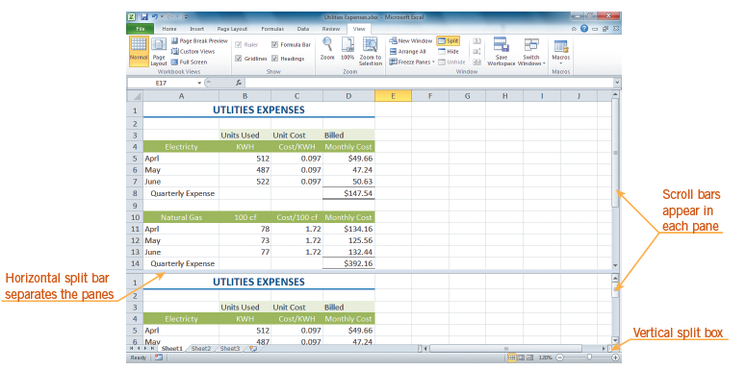
Splitting a Worksheet Window (continued)
Worksheet window split into horizontal panes

Slide 15
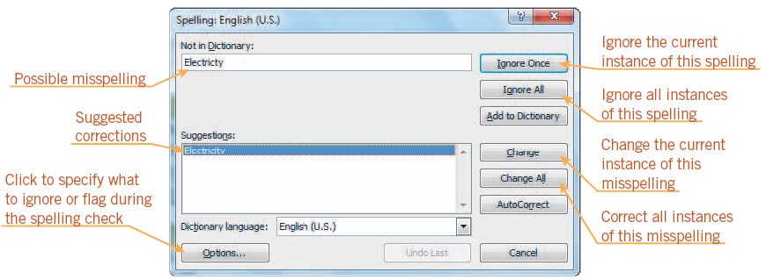
Checking Spelling in a Worksheet
To find and correct spelling errors, use the Spelling command on the Review tab.
15
15

Slide 16
Preparing a Worksheet for Printing
So far, you have worked in Normal view, which is the best view for entering and formatting data in a worksheet.
Page Layout view shows how the worksheet will appear on paper, which is helpful when you prepare a worksheet for printing.
The margin is the blank space around the top, bottom, left, and right sides of a page.
16
16

Slide 17
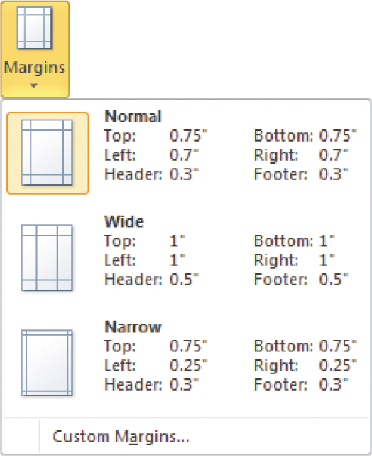
Preparing a Worksheet for Printing (continued)
Margins menu

Slide 18
Preparing a Worksheet for Printing (continued)
By default, Excel is set to print pages in portrait orientation. Worksheets printed in portrait orientation are longer than they are wide. In contrast, worksheets printed in landscape orientation are wider than they are long.
The print area consists of the cells and ranges designated for printing.
18
18

Slide 19
Preparing a Worksheet for Printing (continued)
Excel inserts an automatic page break whenever it runs out of room on a page. You can also insert a manual page break to start a new page.
The simplest way to adjust page breaks is in Page Break Preview. On the status bar, click the Page Break Preview button to switch to this view.
19
19

Slide 20
Preparing a Worksheet for Printing (continued)
Scaling resizes a worksheet to print on a specific number of pages. The Scale to Fit group contains the three options shown below.
Scale to Fit group on the Page Layout tab
20
20

Slide 21
Preparing a Worksheet for Printing (continued)
By default, gridlines, row numbers, and column letters appear in the worksheet but not on the printed page. You can choose to show or hide gridlines and headings in a worksheet or on the printed page.
Print titles are designated rows and/or columns in a worksheet that are printed on each page.
21
21

Slide 22
Inserting Headers and Footers
A header is text that is printed in the top margin of each page. A footer is text that is printed in the bottom margin of each page.
Completed Header section
22
22

Slide 23
Summary
In this lesson, you learned:
You can copy or move data to another part of the worksheet. You can use the Copy, Cut, and Paste buttons, the drag-and-drop method, and the fill handle to copy and move data in a worksheet. These tools save time by eliminating the need to retype data.
As you build a worksheet, you may need to insert a row or column to enter more data, or delete a row or column of unnecessary data. You can also insert or delete specific cells within a worksheet.
23
23

Slide 24
Summary (continued)
When a worksheet becomes large, the column or row labels can scroll out of view as you work on other parts of the worksheet. To keep selected rows and columns on the screen as the rest of the worksheet scrolls, you can freeze panes.
Splitting a large worksheet enables you to view and work in different parts of a worksheet at once, in two or four panes that you can scroll independently.
You can check a worksheet for possible misspellings and correct them using the Spelling dialog box.
24
24

Slide 25
Summary (continued)
When you are ready to print a worksheet, switching from Normal view to Page Layout view can be helpful. You can modify how a worksheet appears on the printed page by increasing or decreasing the margins, changing the page orientation, designating a print area, inserting page breaks, scaling, showing or hiding gridlines and headings, and specifying print titles.
25
25

Slide 26
Summary (continued)
Headers and footers are useful for adding identifying text at the top and bottom of the printed page. Common elements include your name, the page number, the current date, the workbook file name, and the worksheet name.
26
26

